Slide 1
Life Sciences Data Governance Strategy case study Presenter: An Dai
Notes:
This presentation was automatically generated by PowerPoint Copilot based on content found in this document: https://pmicloud-my.sharepoint.com/personal/adai_pmintl_net/Documents/Microsoft%20Copilot%20%E8%81%8A%E5%A4%A9%E6%96%87%E4%BB%B6/Life%20Sciences%20Data%20Governance%20Strategy_%20Why-What-How%20Presentation.pdf AI-generated content may be incorrect.

Slide 2
Agenda
WHY: The Strategic Imperative of data governance
WHAT: Governance Strategy & Framework
HOW: Implementation Strategy (Demo)
WHO: Key Stakeholders & Engagement (Demo)
LESSONS LEARNED
Notes:
Agenda * Introduction * WHY: The Strategic Imperative * Current State Challenges * Strategic Value Opportunity * Key Business Value Metrics by Function * Key Governance Framework Elements * Advanced Governance Capabilities * Function-Specific Governance Focus * HOW: Implementation Strategy * Phase 1: Assessment & Discovery * Phase 2: Framework Development * Phased Implementation Approach * WHO: Key Stakeholders & Engagement * Understanding Governance vs. Management * Function-Specific Implementation Strategy * Governance Structure * LESSONS LEARNED & CONCLUSION * Critical Success Factors * Risk and Value-Based Approach Benefits * Anticipated Questions

Slide 3
Current State Challenges
Lack of Tangible Evidence of Value
Senior management requires clear evidence of data value
Varying Levels of Data Documentation
Different sub-functions have inconsistent documentation practices
Inconsistent Data Ownership Models
Some models are full-time, while others are additional duties
Compliance Mandates
Corporate Data & Analytics team mandates require adherence
Tailored implementation per business needs
Notes:
The current state of data management faces several challenges, including varying levels of data documentation, inconsistent data ownership models, lack of tangible evidence of value for senior management, and compliance mandates from the Corporate Data & Analytics team. Original Content: Current State Challenges Varying levels of data documentation across sub-functions Inconsistent data ownership models (some full-time, some additional duty) Lack of tangible evidence of value for senior management Corporate Data & Analytics team mandates requiring compliance

Slide 4
WHY: Strategic Value Opportunity
Transform data from a compliance burden into a strategic asset that drives business performance across all Life Sciences sub-functions.
Strategy values
Clinical Trials
Standardized metadata reduces study setup time by 20-30%
Poor data quality costs an estimated $5-$10K per amendment
Pre-clinical
Smooth data transfer reduces delays in clinical development by 1-3 months
Improves experiment reproducibility by 40-60%
Regulatory
increases first-cycle approval rates by 15-25%
reduces submission compilation time by 30%
RWE
Increased data reusability and Reduces duplicate data acquisition costs by 15-25%
improve analytical model performance
Enhance decision making through trusted and accessible data
Regulatory compliance and reduced exposure
AI readiness
Accelerate innovation through reusable data assets
Increase operational efficiency across subfunctions
Notes:
Strategic value opportunities include enhanced decision-making with trusted data, regulatory compliance, accelerated innovation with reusable data assets, and increased operational efficiency in life sciences. Original Content: Strategic Value Opportunity Enhanced decision-making through trusted, accessible data Regulatory compliance and reduced risk exposure Accelerated innovation through reliable, reusable data assets Increased operational efficiency across life sciences functions

Slide 5
WHAT: Governance Strategy & Framework Policy to implementation
FAIR data for life science
Value driven & compliance
Centralized metadata (aka data catalogue)
Components
Data Stewardship Model (clear R&R enabled by AI assistant)
AI-powered 5 step lifecycle management
Operationalized FAIR principles
Notes:
Our governance strategy includes a unified data quality framework, comprehensive metadata architecture, risk and value-based approach, formal data stewardship model, GxP compliance framework, and end-to-end data lifecycle management. Original Content: WHAT: Governance Strategy & Framework (3 minutes) Key Governance Framework Elements Unified data quality framework across sub-functions Comprehensive metadata architecture (business glossary, repository, data models) Risk and Value-Based approach aligned with ICH Q9 principles Formal data stewardship model with clear accountability GxP compliance framework with CDISC standards implementation End-to-end data lifecycle management

Slide 6

Function-Specific Governance Focus - no-one fit for all approach
Value driven & compliance
Clinical Trials
Protocol data integrity
Site data quality
eCRF standardization
Submission readiness
Pre-clinical
Experimental reproducibility
Method standardization
Sample traceability
Regulatory
Submission accuracy
Real-World Evidence
Data source credibility, bias control, analytical reproducibility
Notes:
This slide covers key aspects of clinical and pre-clinical trials, including data integrity, quality, and standardization. It also highlights regulatory requirements and the importance of real-world evidence. Original Content: Clinical Trials: Protocol data integrity, site data quality, eCRF standardization, submission readiness Pre-clinical: Experimental reproducibility, method standardization, sample traceability Regulatory: Submission accuracy, global consistency, change control, document versioning Real-World Evidence: Data source credibility, bias control, analytical reproducibility

Slide 7
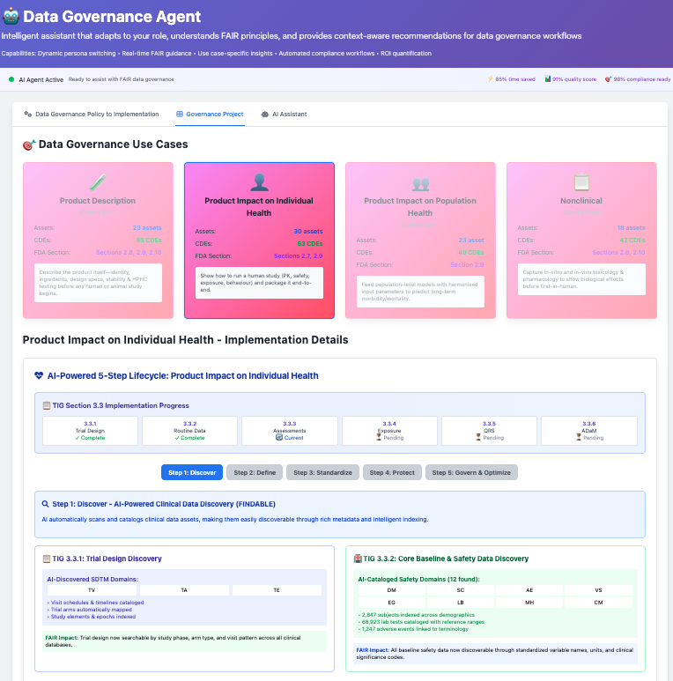
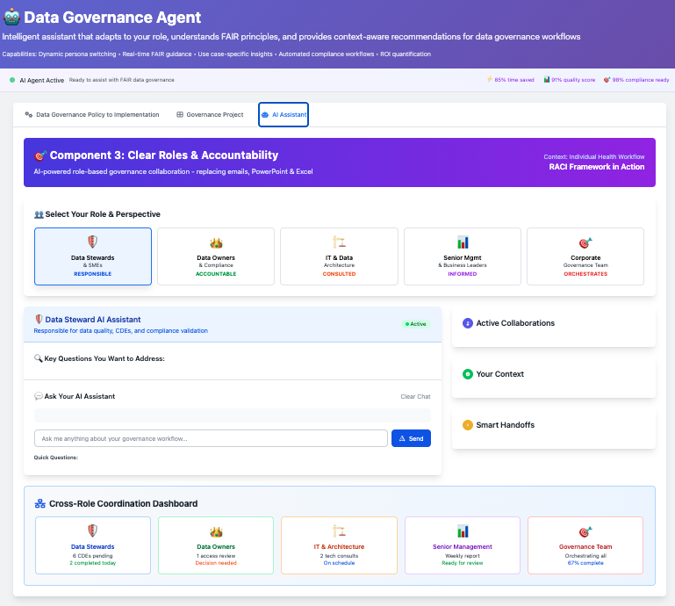
Demo – how & who

Slide 8
LESSONS LEARNED
Data governance exists to serve business needs—like regulatory compliance, process efficiency, and AI-readiness—not as an end in itself.
Executive sponsorship comes from demonstrating real business value, not just talking about governance.
Clear roles and responsibilities must be supported by tools that make governance easy, not add more work (they should be part of the tool design)
Governance success must be measured by its impact on business outcomes, like risk reduction and improved AI readiness.
Ultimately, governance must unlock data context for AI and decision-making—making data ready, relevant, and trusted (data catalogue becomes even more important)
Notes:
In conclusion, executive sponsorship is crucial. Start with a business glossary and focus on high-value use cases. Balance standardization with specific needs. The risk and value-based approach aligns with regulatory expectations, allocates resources efficiently, provides continuous monitoring, and demonstrates business value. Original Content: LESSONS LEARNED & CONCLUSION (1 minute) Critical Success Factors Executive sponsorship is non-negotiable Start with business glossary to establish common language Begin with high-value, high-visibility use cases Balance standardization with function-specific needs Risk and Value-Based Approach Benefits Aligns with regulatory expectations (FDA, EMA) and ICH Q9 principles Enables efficient resource allocation to highest-risk and highest-value data assets Provides framework for continuous monitoring and improvement Demonstrates tangible business value while ensuring regulatory compliance

